Slide 1

Dynamic properties of one class of impulse systems
Postgraduate student,
Faculty of computer science,
Ivanovsky Leonid

Slide 2
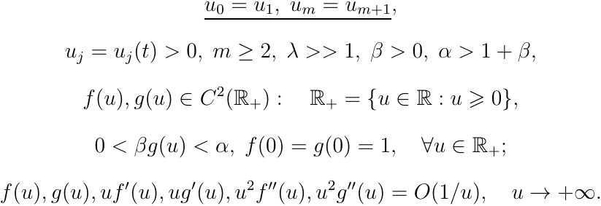
Dynamic system

Slide 3
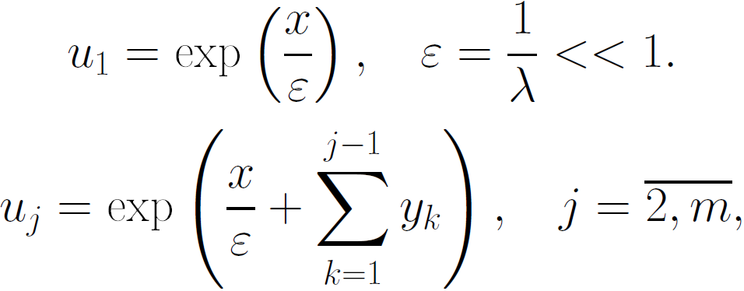
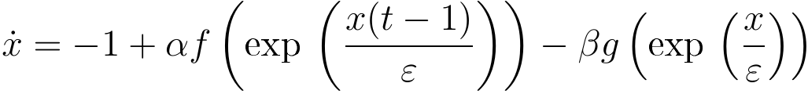
Substitutions

Slide 4
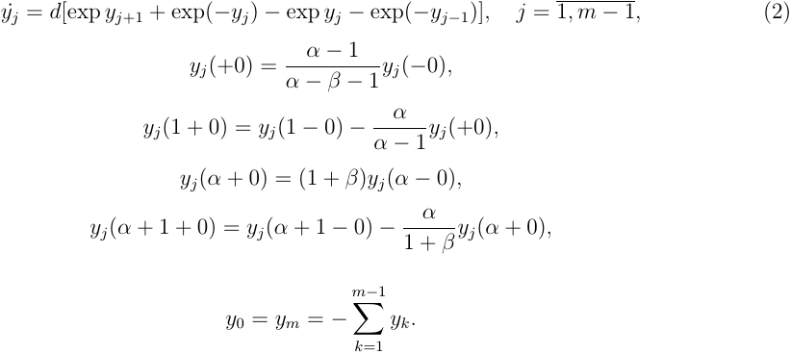
Limit impulse system

Slide 5


Research mapping

Slide 6




Method of research

Slide 7
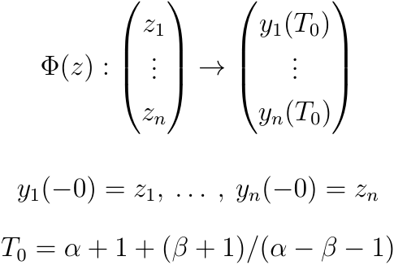

Slide 8
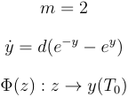
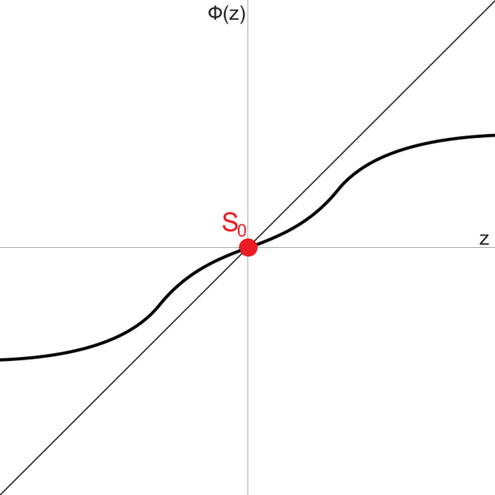
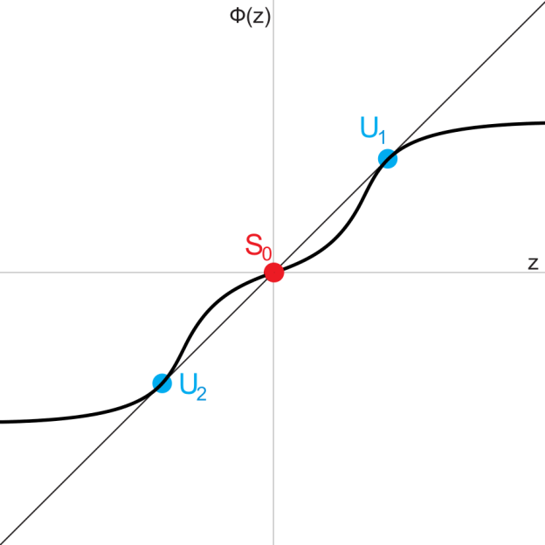
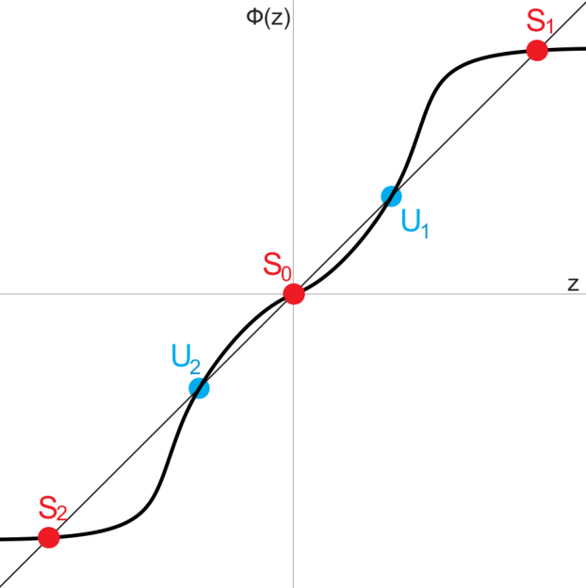

Results of research: one-dimensional case
d=0.025
d=0.02175
d=0.015

Slide 9
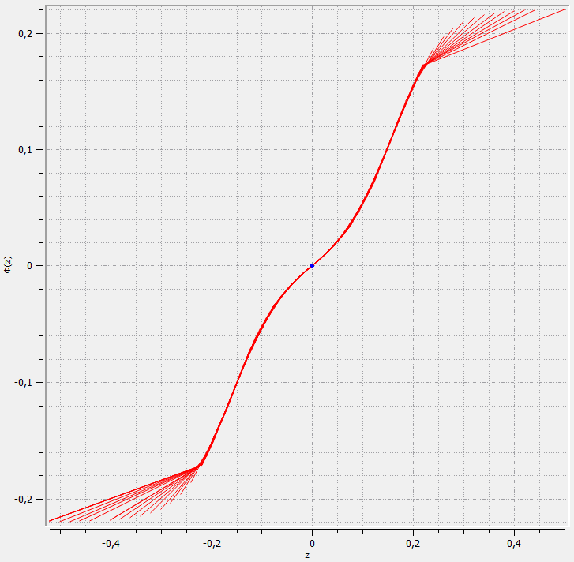
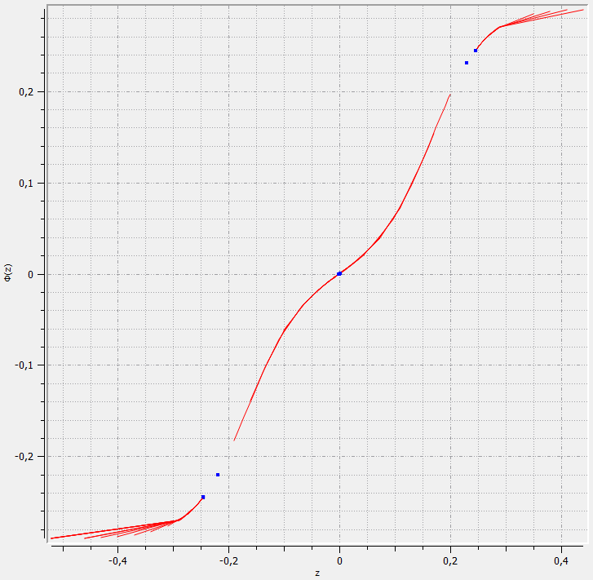
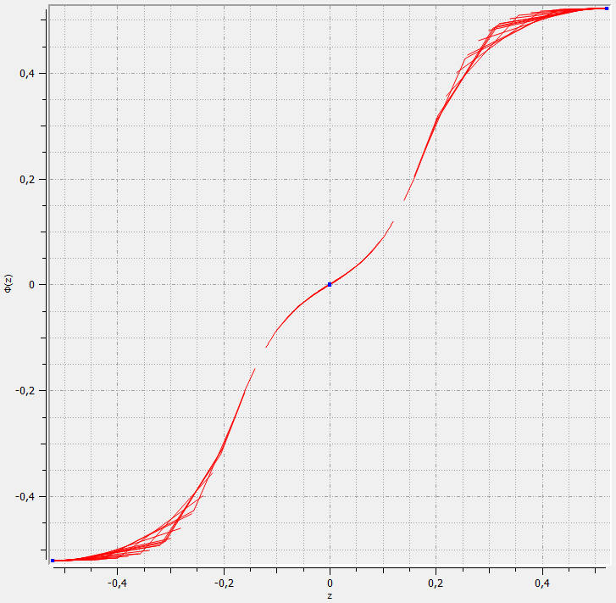
Screenshots of program for one-dimensional-case
d=0.025
d=0.02175
d=0.015

Slide 10
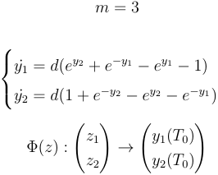
Results of research: two-dimensional case

Slide 11
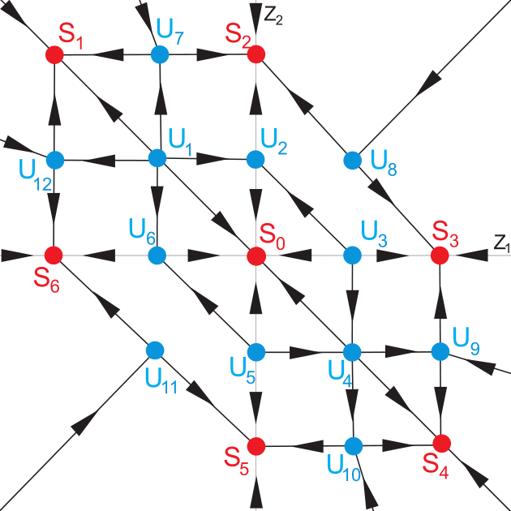
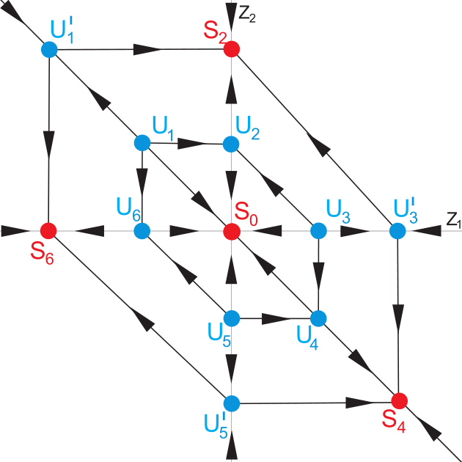
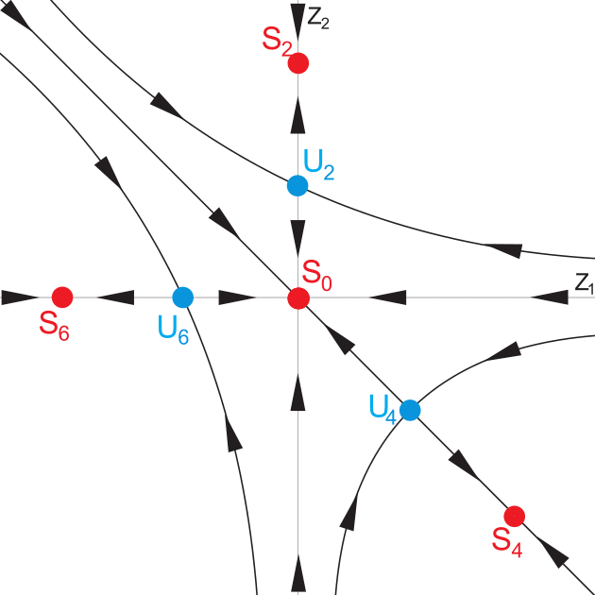

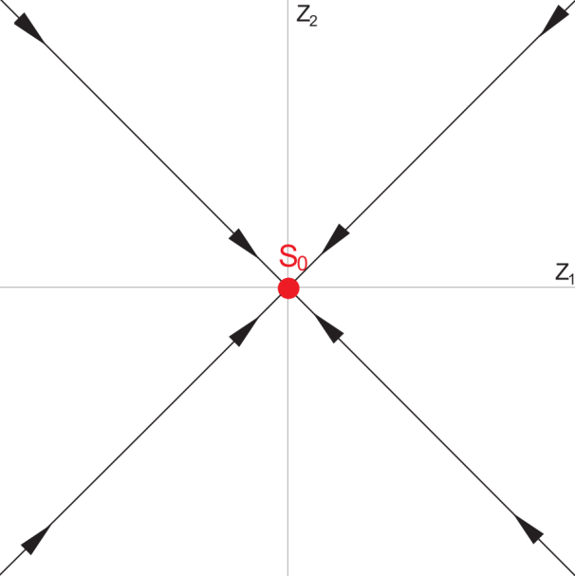
Bifurcations
d<0.003
0.003<d<0.006
0.006<d<0.021
d>0.021

Slide 12
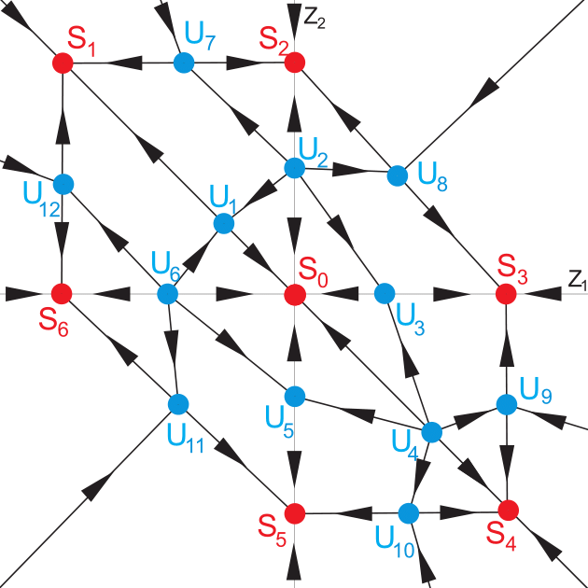
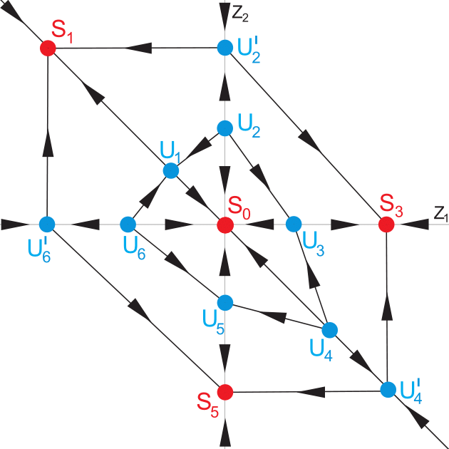
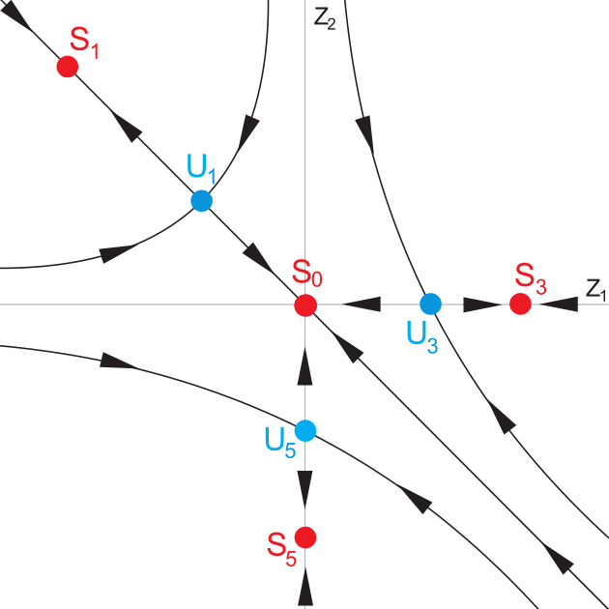

Bifurcations
d<0.021
0.021<d<0.031
0.031<d<0.058
d>0.058

Slide 13
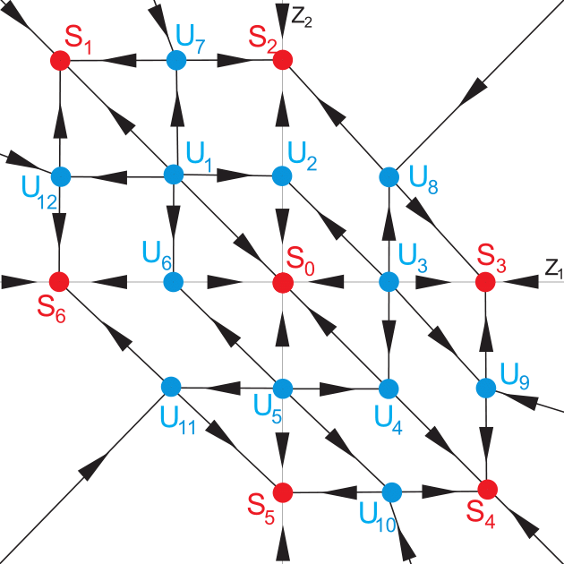
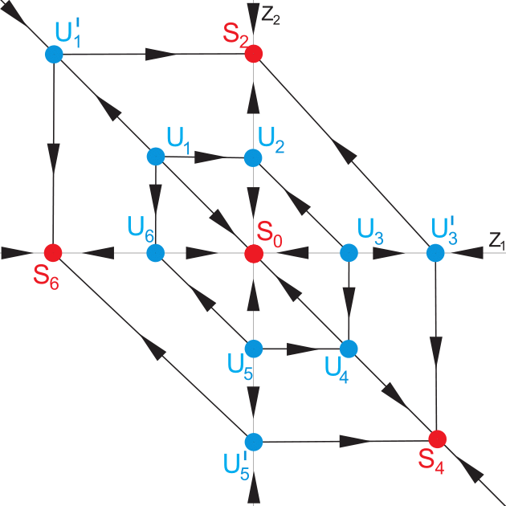
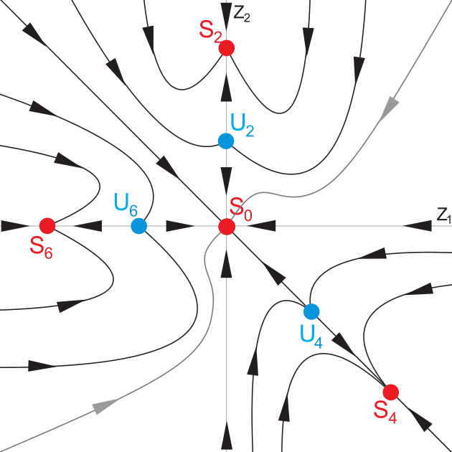

Bifurcations
d<0.05
0.05<d<0.052
0.052<d<0.057
d>0.057

Slide 14
Thanks for your attention!

